Slide 1
Java IO
B.Ramasubramanian

Slide 2
IO Streams
Input streams
Classes which are used to read data from source and source can be a file, or peripheral device etc.
Output streams
Classes which are used to write data to a destination and destination can be a file or peripheral device etc.
Byte Streams
These classes used to process data byte by byte
Character Streams
These classes allow us to read/write data character by character.

Slide 3
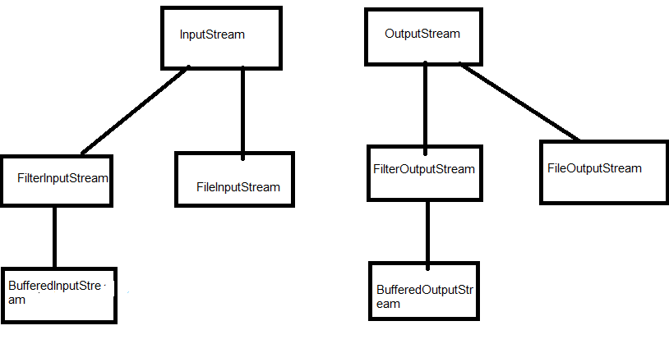
Byte Stream classes hierarchies

Slide 4
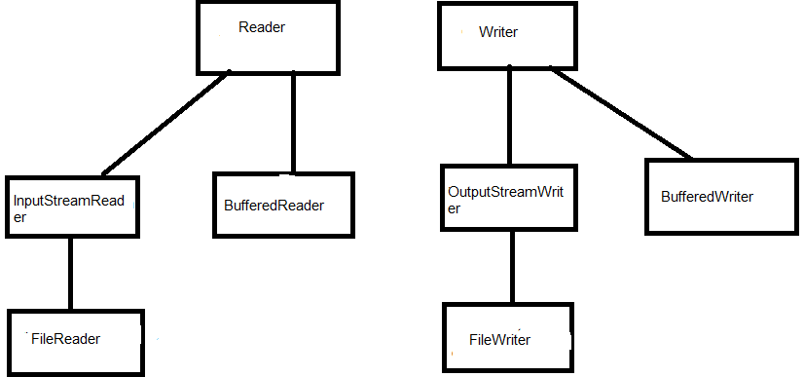
Character Stream classes hierarchies

Slide 5
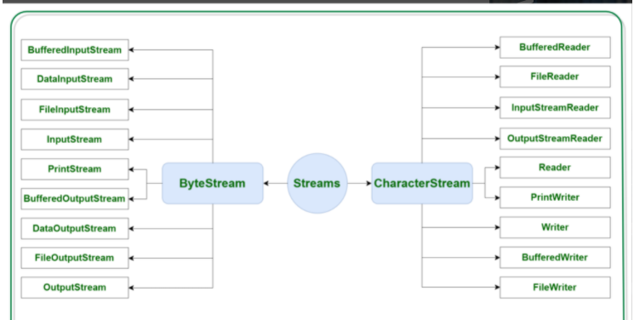
IO classes classsification

Slide 6
BufferedInputStream
They are used to read information from stream and uses buffer to improve performance.

Slide 7
FileReader
The difference between FileInputStream and FileReader is, FileInputStream reads the file byte by byte and FileReader reads the file character by character.
FileInputStream is meant for reading streams of raw bytes such as image data. For reading streams of characters, consider using FileReader.

Slide 8
Serialization and deserialization
Serialization:
Serialization in Java is a mechanism of writing the state of an object into a byte-stream.
Deserialization:
The reverse operation of serialization is called deserialization where byte-stream is converted into an object

Slide 9
ObjectOutputStream
This class is used to serialize java objects

Slide 10
ObjectInputStream
This object is used to deserialize a Java object

Slide 11
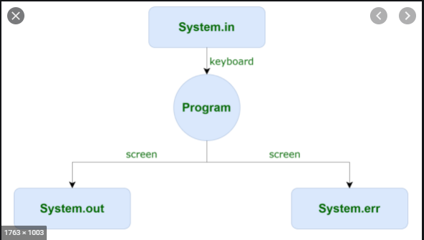
Standard Streams

Slide 12
Standard Streams
The class System contains three predefined stream variables as below
in---refers to standard input(keyboard)
out---refers to standard output(console)
err----refers to standard error stream (console)
All the above variables are declared public,static,final.

Slide 13
Standard Streams
System.in holds the object reference of InputStream.
System.out holds the object reference of PrintStream
System.err holds the object reference of PrintStream.

Slide 14
Standard Streams
PrintStream class has the following methods.
Print()
Println()
System.out.println() is equivalent to calling PrintStram ps = new PrintStream();
Ps.println();

